Slide 1
SENTIMENTAL ANALYSIS
PROJECT IS SUBMITTED BY TEAM NAME :
PROCODER
COLLEGE:MEERUT INSTITUE OF ENGINEERING AND TECHNOLGY

Slide 2
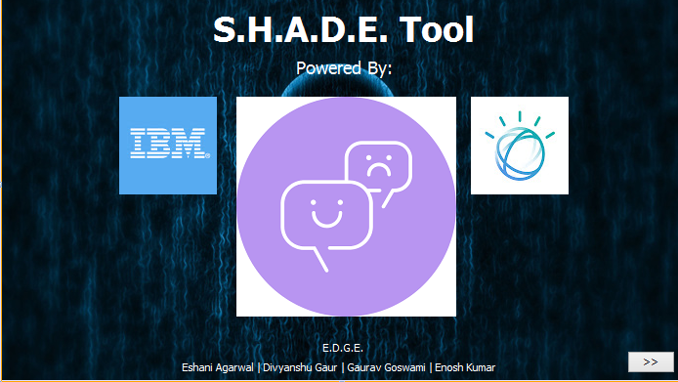
SOCIAL MEDIA HEALTH ANALYSIS AND DISPLAY ENGINE

Slide 3
PROBLEM STATEMENT:
Help me with my Mood-With Social-media Health Analysis and Display Engine(SHADE).
With the advances in technology about sentiment analysis and predictive analytics, it has opened many avenues for researchers and enterprises to understand human mental state better. The proposed challenge is to know the emotion/mood of a person, to help in eliminating any negative state of mind that might have adverse effect on his/her daily life.

Slide 4
TEAM MEMBERS AND THEIR ROLE
DIVYANSHU GAUR (Programmer)
GAURAV GOSWAMI (UI/UX Designer)
ESHANI AGARWAL (Documentation Writer)
ENOSH KUMAR (Tester)

Slide 5
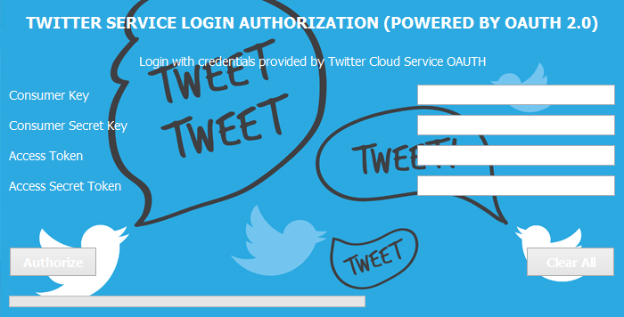
FLOW OF CONTROL:
Step 1: In the first step the user will try to login
to his twitter developer account using his/her
credentials (Consumer Key, Consumer Key Secret ,Access Token, Access Token Secret).

Slide 6
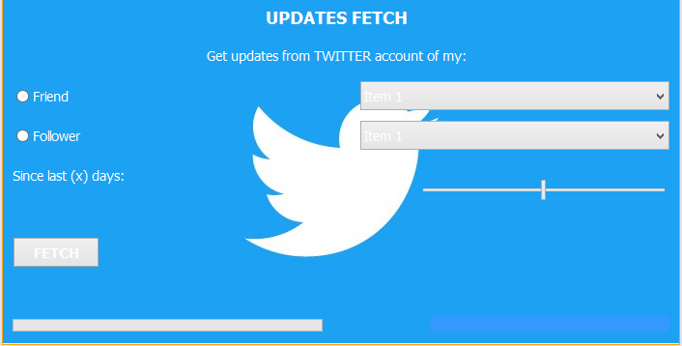
STEP 2:In this step user will select the name of his/her friend or follower whose social activity status we need to find. He/she will also select the duration .

Slide 7
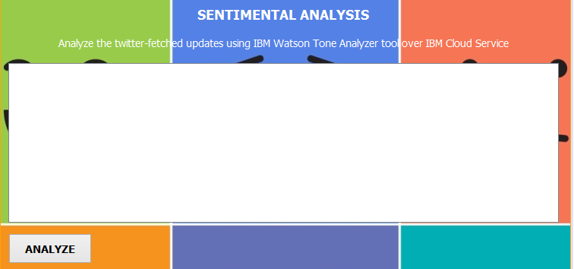
Step 3:Here the social activity is extracted and analysed. After analysis all the mood depicted in his past activity are displayed.

Slide 8
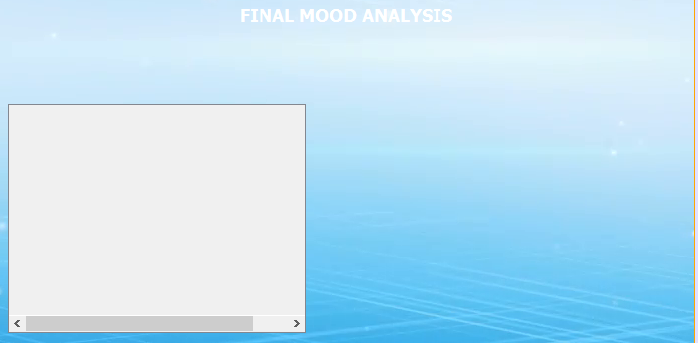
Step 4:Here the most prominent mood(prior to negative mood)is displayed. And then to soothe or calm his/her mood a song from his/her curated playlist will play.

Slide 9
TECHNIQUES/PLATFORMS/API’S USED:
TECHNIQUE:
Java(EE) and Java(SE) as technology.
PLATFORM:
Netbeans 8.2 as platform
API:
Twitter4j,IBM Watson tone analyser as API
IBM cloud

